Slide 1
Front End Engineering-II Project
Team Details: Uday Singh (2210992473)
Vaibhav (2210992490)
Vaibhav (2210992491)
Vedanash (2210992519)
Faculty Coordinator: Mr. S.K Ansari
:
Chitkara University Institute of Engineering and Technology,
Chitkara University, Punjab

Slide 2
Abstract
This paper presents the design and implementation of a modern food ordering website aimed at enhancing the user experience and streamlining the process of ordering meals from local restaurants. The platform integrates intuitive user interfaces, robust back-end support, and seamless payment gateways to provide a comprehensive solution for both customers and restaurant owners. Key features include a dynamic menu system, real-time order tracking, personalized recommendations powered by machine learning algorithms, and an efficient order management system for restaurant staff. User testing indicates high satisfaction rates due to the ease of navigation, speed of transactions, and accuracy of order deliveries. This website not only improves customer convenience but also supports local businesses by providing them with a scalable and easily manageable online presence. Future enhancements are planned to include advanced analytics for restaurant partners and expanded delivery logistics options to further optimize the service.

Slide 3
Introduction
Welcome to the unveiling of Food Delight, where innovation meets culinary convenience. In today's fast-paced world, the demand for seamless food delivery solutions is ever-growing. Our project aims to address this need by leveraging the power of React to develop a user-centric food delivery app. With a focus on intuitive design, real-time tracking, secure transactions, and cross-platform accessibility, we're poised to redefine the dining experience. Join us on this journey as we revolutionize the way food is delivered and enjoyed.
At [Your Food Delivery App Name], we recognize the pivotal role technology plays in modern dining habits. With the surge in online food ordering, our project endeavors to provide a seamless solution that caters to the evolving needs of consumers and businesses alike. By amalgamating cutting-edge React development with a passion for gastronomy, we're committed to crafting an app that not only simplifies the ordering process but also enhances the overall dining experience. Get ready to embark on a gastronomic journey like never before with [Your Food Delivery App Name].

Slide 4
Problem Statement
Traditional food delivery methods are plagued with inefficiencies and limitations.
Users face challenges such as long wait times, order inaccuracies, and limited menu options.
Lack of real-time order tracking leads to uncertainty and frustration.
Market trends indicate a growing demand for online food delivery services.
Our project aims to address these challenges by developiTraditional food delivery methods are plagued with inefficiencies and limitations.
Users face challenges such as long wait times, order inaccuracies, and limited menu options.
Lack of real-time order tracking leads to uncertainty and frustration.
Market trends indicate a growing demand for online food delivery services.
Objective:
Our project aims to address these challenges by developing a user-friendly and efficient food delivery app using React.ng a user-friendly and efficient food delivery app using React.

Slide 5
Technical Details:
• REACT: The HyperText Markup Language or HTML is the standard markup language for documents designed to be displayed in a web browser. It is often assisted by technologies such as Cascading Style Sheets (CSS).
• CSS (Cascading Style Sheets): CSS stands for Cascading Style Sheets. It is a style sheet language which is used to describe the look and formatting of a document written in markup language. It provides an additional feature to HTML. It is generally used with HTML to change the style of web pages and user interfaces. CSS style the form elements, including changing the font, color, size, and layout. You can use CSS selectors to target specific input elements or groups of input elements.
• JavaScript: React is an open-source JavaScript library for building user interfaces, primarily used for creating interactive and dynamic web applications. Developed by Facebook, React allows developers to build reusable UI components that efficiently update when data changes.

Slide 6
Preview:

Slide 7
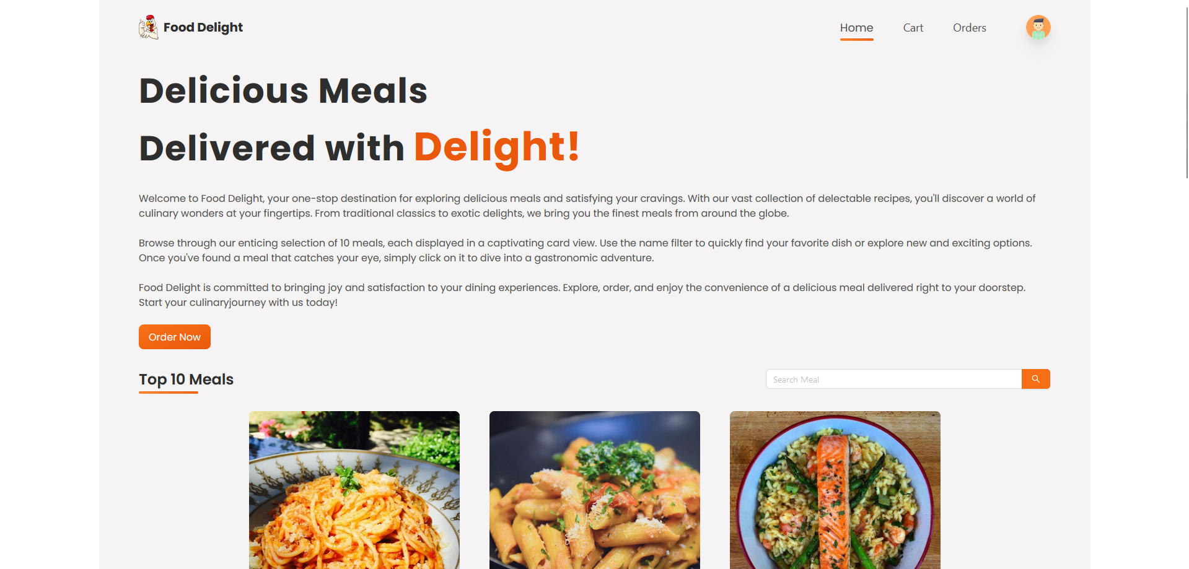
Home Page

Slide 8
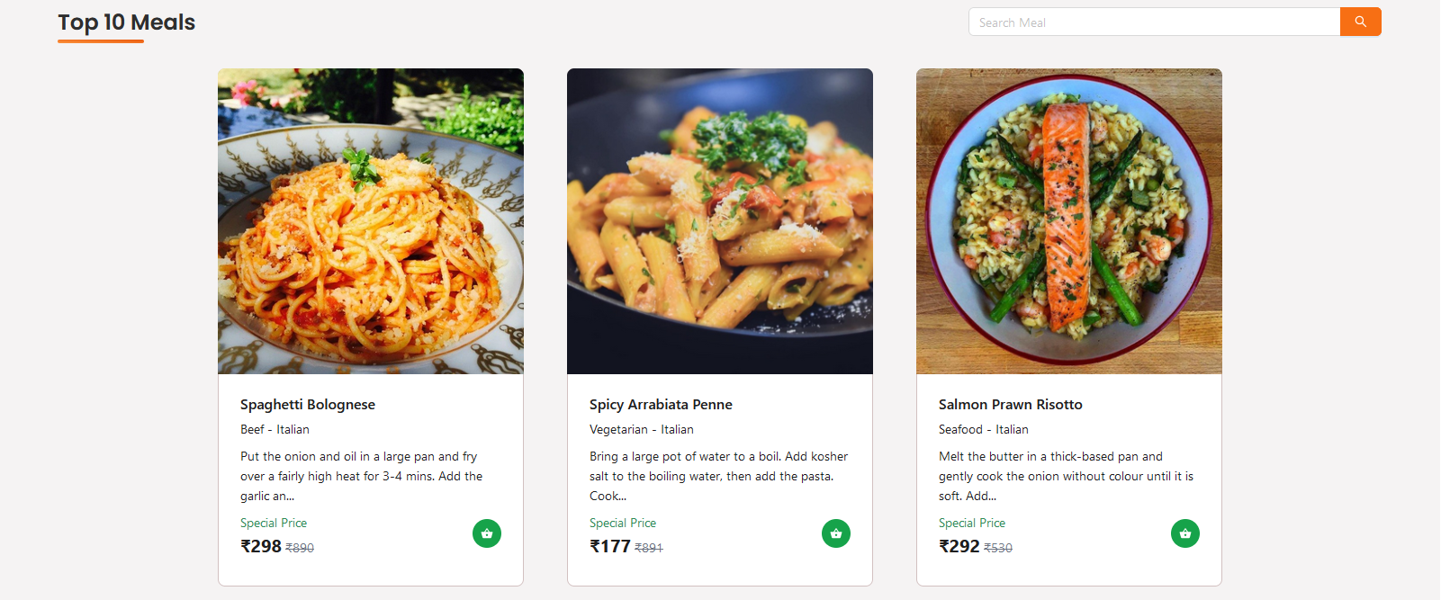
Meals

Slide 9
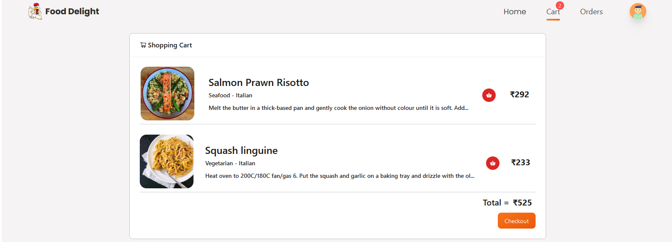
Cart

Slide 10
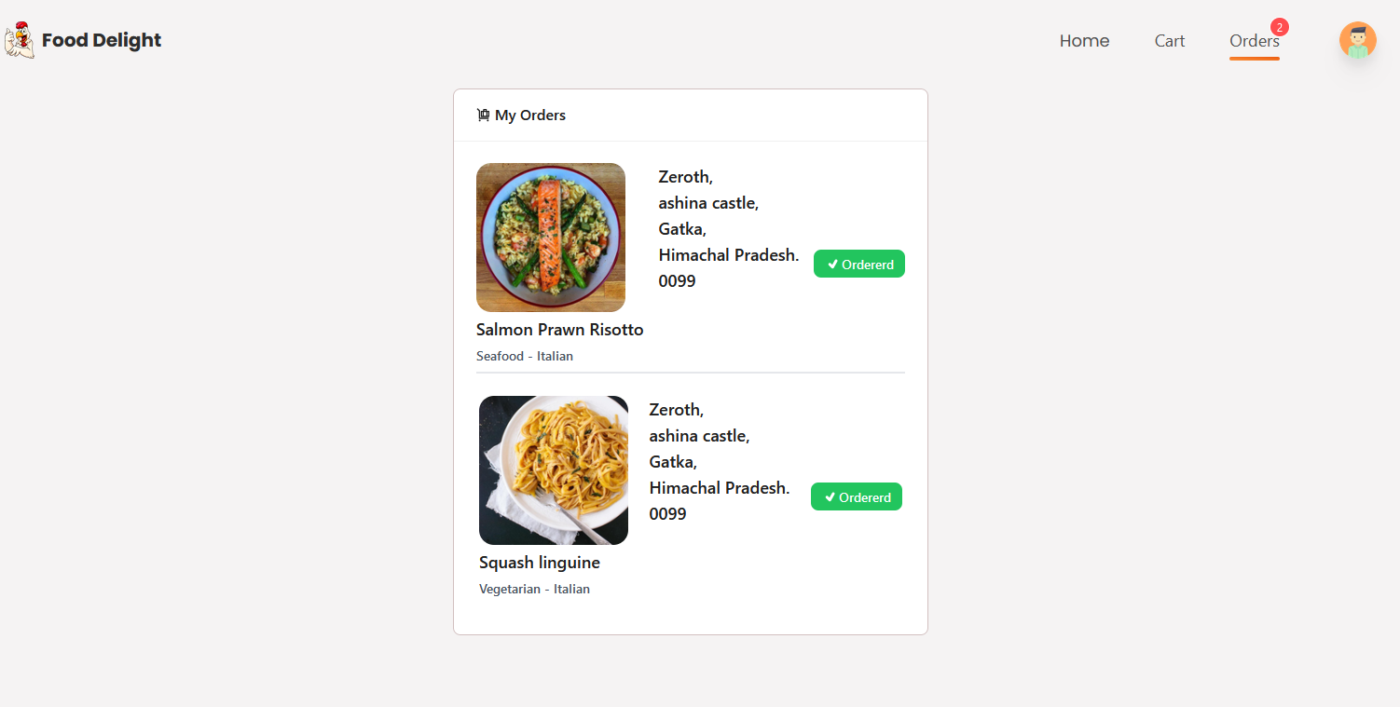
Orders

Slide 11
Key Features
1. Personalized Fitness Challenges: Tailored fitness challenges designed for various fitness levels and
goals, providing participants with targeted workouts and nutrition plans to meet their specific needs.
2. Expert Guidance: Access to professional fitness coaches and trainers who offer personalized support, advice, and motivation throughout the challenge journey.
3. Community Support: A vibrant online community where participants can connect, share experiences, and support each other, fostering a sense of camaraderie and accountability.
4. Progress Tracking: Comprehensive tracking tools and metrics to monitor progress, celebrate achievements, and stay motivated, empowering participants to track their fitness journey effectively.

Slide 12
Advantages
User-Friendly Interface: The platform offers an intuitive and easy-to-navigate interface, ensuring that users can effortlessly browse menus, place orders, and make payments. This reduces the time and effort required for customers to order food, enhancing their overall experience.
Real-Time Order Tracking: Customers can track their orders in real-time, providing transparency and reducing uncertainty about delivery times. This feature helps in building trust and satisfaction, as users are kept informed about the status of their orders from preparation to delivery.
Personalized Recommendations: Leveraging machine learning algorithms, the website provides personalized meal recommendations based on users' past orders and preferences. This not only improves the user experience by making it easier to discover new dishes but also increases the likelihood of repeat orders.
Efficient Order Management for Restaurants: The system includes a comprehensive order management dashboard for restaurant staff, streamlining the process from order receipt to fulfillment. This helps in minimizing errors, reducing wait times, and improving overall operational efficiency, allowing restaurants to handle more orders with greater accuracy.

Slide 13
Future Scope
1. Expansion of Offerings: The platform can expand its range of fitness challenges to cater to a broader audience, including specialized programs for specific demographics, such as seniors, children, or individuals with specific health conditions.
2. Integration of Technology: Embracing advancements in technology, such as virtual reality, artificial intelligence, and wearable devices, can enhance the user experience, improve tracking accuracy, and offer more interactive and immersive fitness experiences.
3. Corporate Wellness Programs: Partnering with businesses to offer corporate wellness programs can open up new avenues for promoting employee health and productivity, leading to potential partnerships and revenue streams.
4. Global Reach: With the rise of online communities and digital connectivity, the platform can explore opportunities to expand its reach globally, tapping into international markets and connecting with individuals from diverse backgrounds and cultures.

Slide 14
References
https://darebee.com/challenges.html
https://www.w3schools.com/html/
https://timesofindia.indiatimes.com/education/web-stories/top-10-most-popular-college-fests-in-india/photostory/99591815.cms
https://www.google.com/
https://chat.openai.com/

